Slide 1
Lego Project
Optimizing Lego Car Design for Maximum Performance
Team Members
Akash Kumar
Anila Scaria
Parv Khandelwal
Preveen Veerakumar
Te-Chun Chou

Slide 2
01
Agenda
Project Objectives and Goals
02
Experimental Set-up
03
Description For Factors and Response Variable
04
Data Analysis
05
Financial Analysis
06
Conclusions & Recommendations

Slide 3

Project Objectives and Goals

Slide 4
The goal of this project is to design a Lego race car that travels the farthest distance down a ramp.
We will use Design of Experiments (DOE) to test and optimize key factors affecting performance while keeping the design cost-effective. By analyzing the results using Minitab, we aim to:
(1) Test different car configurations.
(2) Find the best design for maximum performance.
(3) Learn and apply DOE techniques.

Slide 5
Experimental Setup

Slide 6
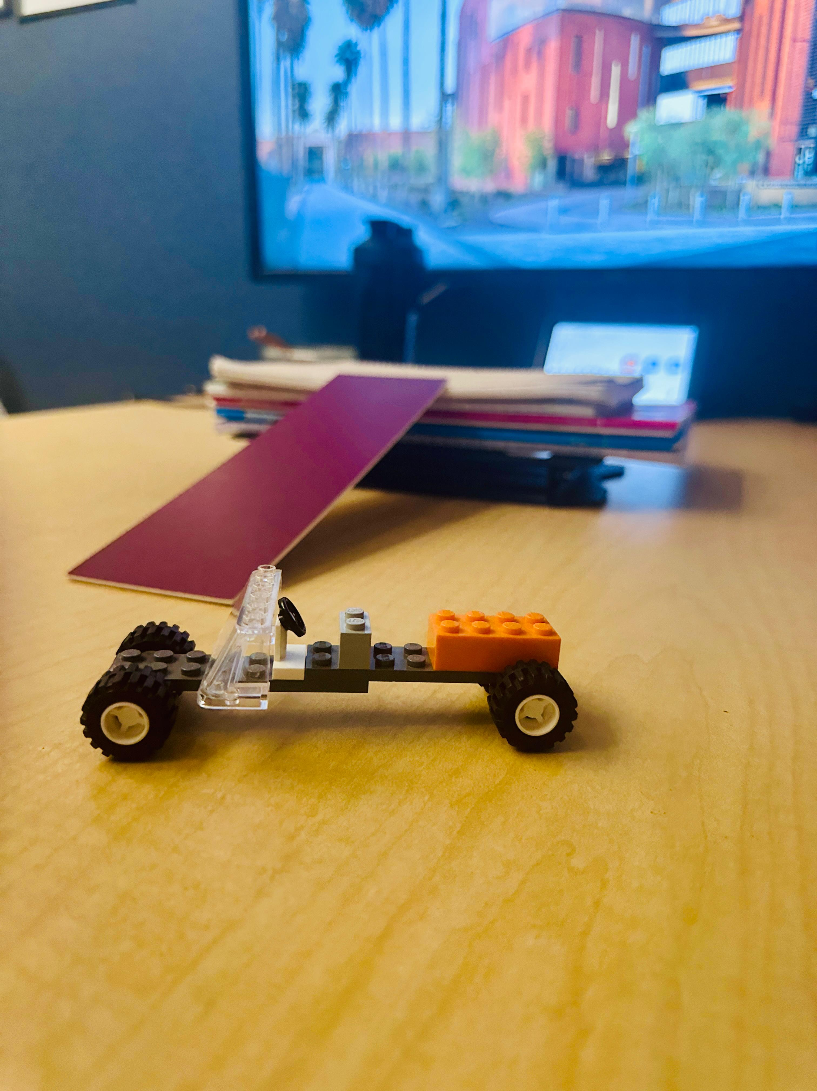
Ramp Construction:
Built using materials like books and cardboard.
Height, length, and angle were kept constant for consistency.
Testing Area:
Conducted on a flat surface to minimize external factors.
Distance was measured using a tape measure.
Car Configurations:
Tested different designs by changing factors like wheel
Randomization:
Used Minitab to randomize test order and reduce bias.
Replications:
Each design was tested multiple times for reliable results

Slide 7

Description for Factors & Response Variable

Slide 8
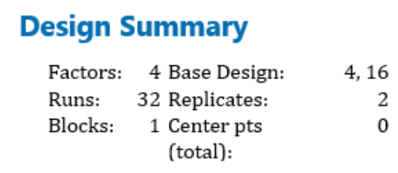
Factors
Front Wheel Size
Changed from large to small to test its impact on distance.
Rear Wheel Size
Adjusted from large to small to see if it increases distance.
Rear Weight Distribution
The weight behind the driver seat was added to check its effect on distance.
Front Weight Distribution
Placed weight in front of the windshield to determine its impact on distance.
Response Variable
The response variable for this experiment is the distance traveled by the Lego car. It is measured as the horizontal distance (in centimeters or meters) from the end of the ramp to the car's final resting point after being released. This variable is used to evaluate the effectiveness of different design configurations in maximizing performance.

Slide 9
The factors in this experiment are chosen to explore how design changes in a Lego car affect its distance traveled after being released from a ramp.
Adjusting front and rear wheel sizes tests their impact on friction, traction, and speed, while modifying weight distribution (front and rear) evaluates how shifting the car's balance influences its movement and distance.
These factors aim to determine how design changes maximize performance by altering friction, balance, and speed.

Slide 10

Data Analysis

Slide 11
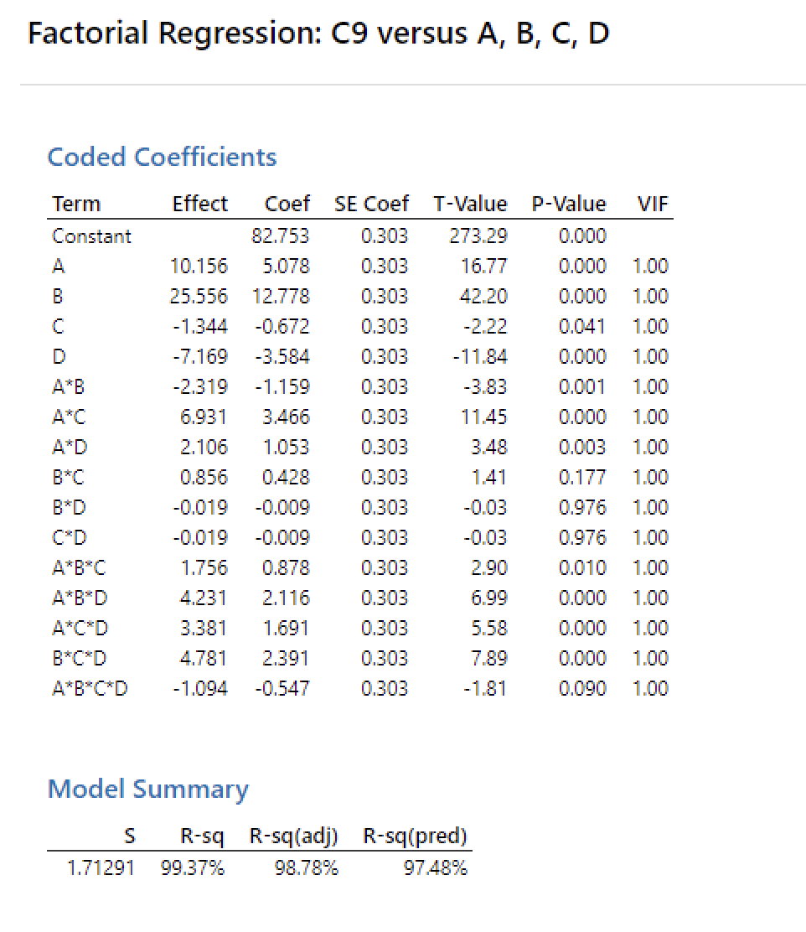

Slide 12
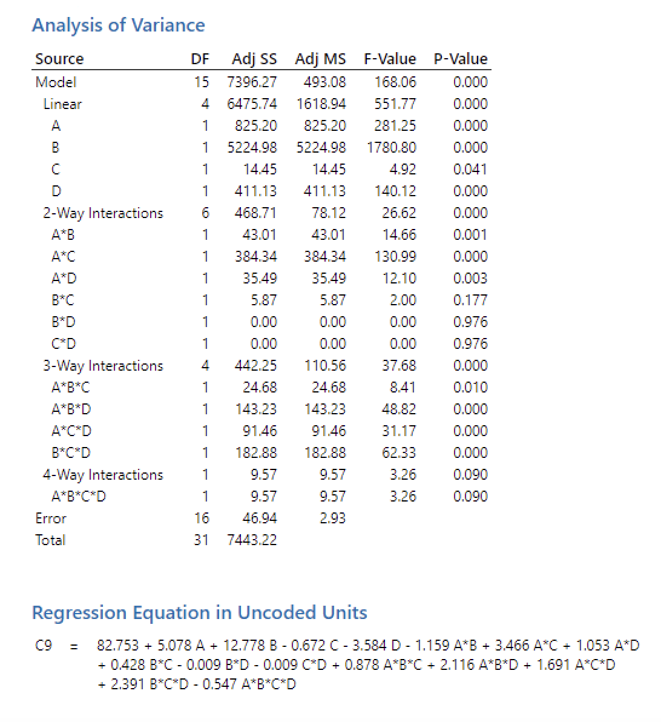

Slide 13
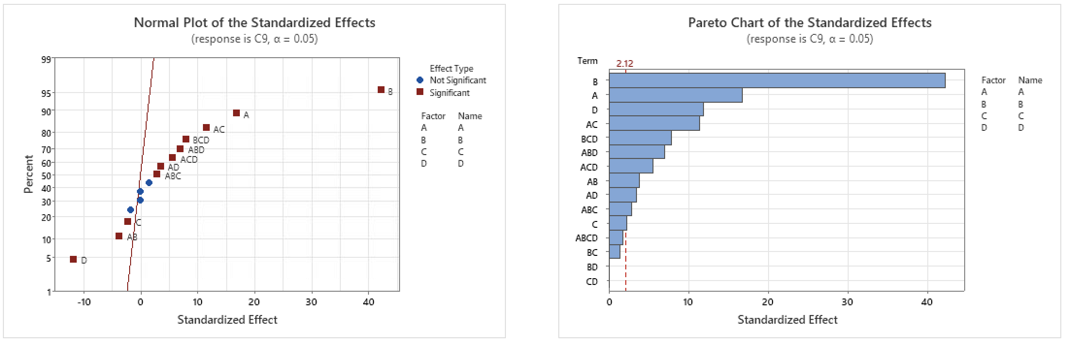
Two key plots Analyze Factors and interactions in a Statistical Model

Slide 14
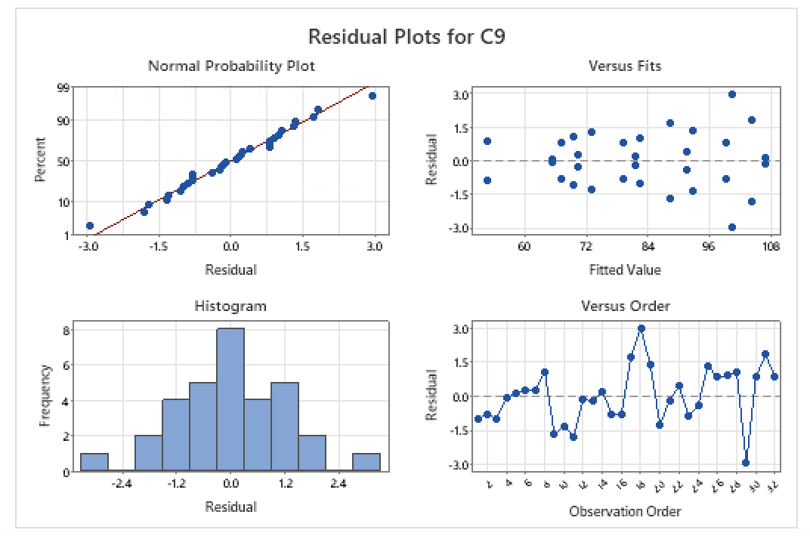
Residual Analysis for Checking Regression Assumptions and Model Fit

Slide 15

Data Analysis After Removing Insignificant Effects

Slide 16
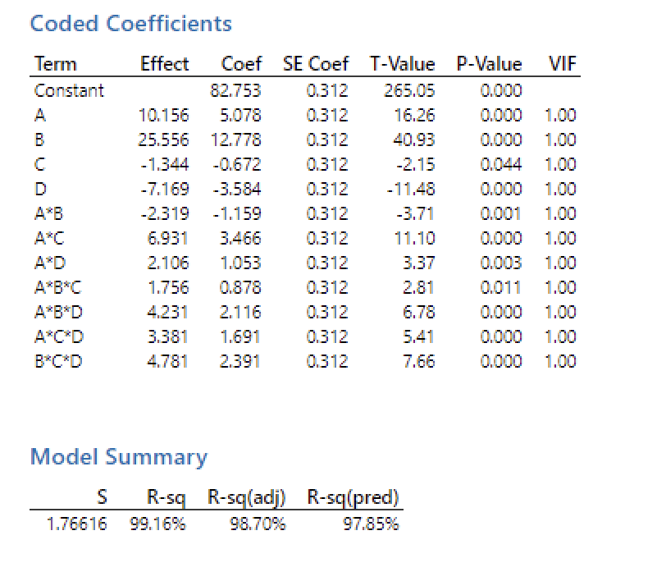

Slide 17
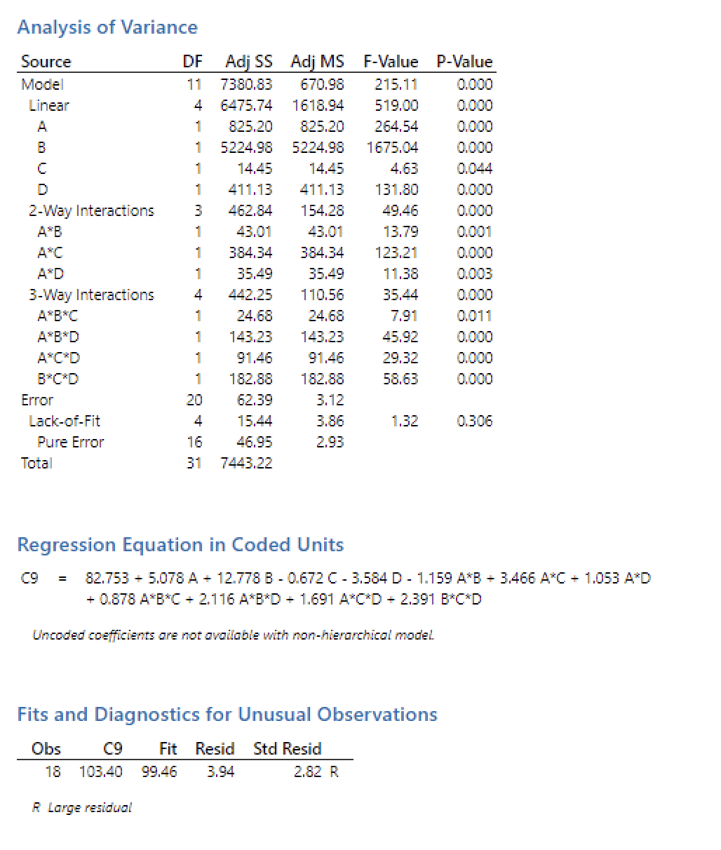

Slide 18
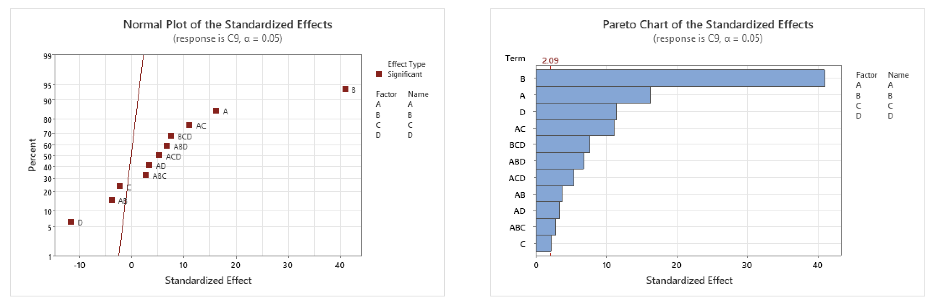
Two key plots Analyze Factors and interactions in a Statistical Model

Slide 19
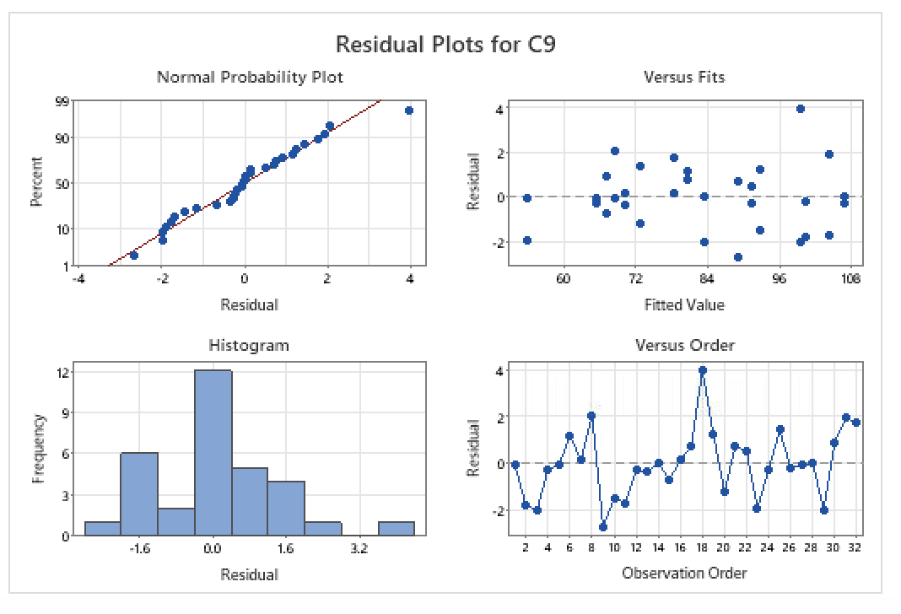
Residual Analysis for Checking Regression Assumptions and Model Fit

Slide 20

Financial Analysis

Slide 21
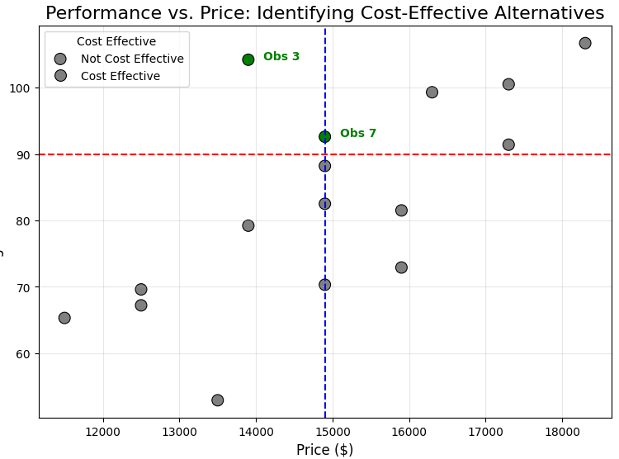
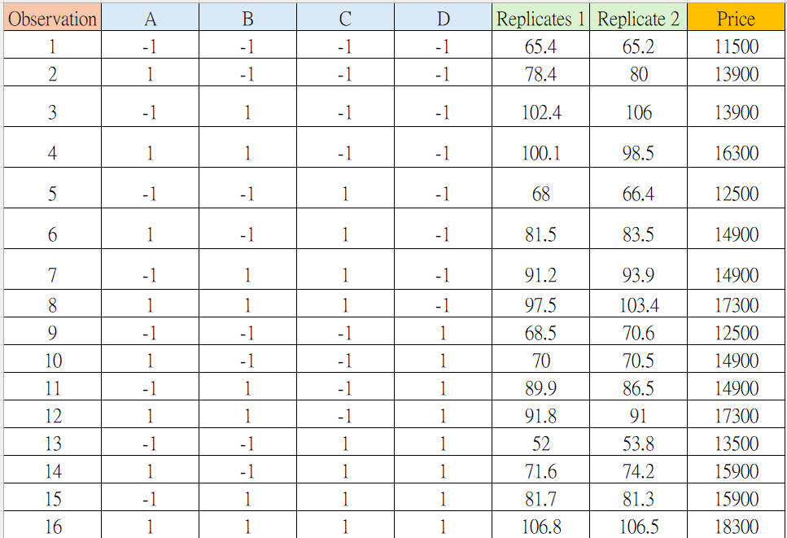

Slide 22
Finding High Performance, Low Cost
Criteria
High Performance: Average performance > 90
Low Cost: Price ≤ 14,900
From the table
Observation 3 meets these criteria
Average Performance = 104.2
Price = 13,900
How to improve cost effectiveness?
For factors with minimal impact on performance but high costs, set them to levels that reduce cost.

Slide 23
Conclusions & Recommendations

Slide 24
Conclusions:
Optimal Configuration Identified:
• Observation 3 achieved the best balance with:
• High performance: Average distance > 90.
• Cost-effectiveness: Price ≤ 14,900.
Key Design Insights:
• Adjustments to wheel size and weight distribution significantly improved distance performance.
• Statistical validation ensured the robustness and reliability of the model.
Cost-Performance Trade-Off:
Identified high-cost factors with minimal performance impact as areas for potential cost savings.

Slide 25
Recommendations:
Use larger datasets for better generalization and prediction accuracy.
Explore advanced DOE techniques for further performance optimization.
Focus on reducing costs by refining non-critical design elements.
Implement a continuous validation framework to ensure new designs perform as expected under varying conditions.

Slide 26
THANK YOU

